Slide 1



P2P- LENDING CLUB
Mentored By
Pooja Vijaykumar, Data Scientist – Dono Consulting
Presented By:
Sravan Jindam Noah Sheldon Vishakha Gupta Sivalakshmi Mavilla

Slide 2
LENDING CLUB ANALYSIS OVERVIEW
Overview of Lending Club
Identifying the Business Problem
Data Description
Milestones
Data Preparation and Preprocessing
Feature Engineering
Dropped Variables
Models
Logistic Regression
Decision Trees
Random Forest
Bagging and Boosting Classifier
K-Nearest Neighbor
Neural Networks
UI Demo
Conclusion

Slide 3

Overview of Lending Club
Lending Club is a Peer-to-Peer lending company that utilizes a group of private investors to fund loan requests.
Lending Club’s model for risk assessment categorizes borrowers by assigning them a grade and a subgrade based on their credit history.
Investors are presented with a list of borrowers, along with their assigned risk assessment grades, and they can choose which borrowers they will fund, and the percentage of funding that they will cover.
Our business problem is that investors require a more comprehensive assessment of these borrowers than what is presented by Lending Club in order to make a smart business decision, by identifying new borrowers that would likely default on their loans.

Slide 4
Identifying the Business Problem
To predict whether a loan is accepted or not.
To predict whether a person will default on paying his loan.
Create a UI which predicts defaults and predicts the probability of acceptance of each loan.

Slide 5
Data Description
Lending Club provided us with 4 years of historical data (2012-2015). This dataset contained information pertaining to the borrower’s past credit history and Lending Club loan information. The total dataset consisted of over 800,000 records, which was enough for our team to conduct analysis models.
Variables present within the dataset provided an ample
amount of information which we could use to identify
relationships and gauge their effect upon the success
or failure of a borrower fulfilling the terms of their loan
agreement.
We required only the variables that had a direct or indirect response to a borrower’s potential to default. To achieve this, we prepared the data by choosing select variables that would best fit this criteria.

Slide 6
Milestones
Pre-processing:
Getting all required columns from 150 columns.
Feature engineering:
Extracting features from dataset
Modelling:
predict probability of acceptance of each loan
If accepted, predict the likelihood of default
Automating – UI platform:
The entire project is to be automated, so that when a single line/or set of new loans are uploaded, the UI will predict defaults and when a set of new loan applications are uploaded, the UI will predict the probability of acceptance for each.

Slide 7
DATA PREPARATION & PROCESSING
Merged all Loanstats into a single CSV file named FULLACC.
Merged all Rejectstats into a single CSV file name FULLREJ.
We have assigned ACCEPTED feature as 1 in ACCMERGE CSV file.
We have assigned ACCEPTED feature as 0 in REJMERGE CSV file.
For the FULLACC dataset:
Removed rows where loan_amt = 0
DTI – Calculated as dti/100
lndti1 = log of dti
Int_rate: replace “%” with “e-2” --- and then convert it to numeric
Emp_length: “n/a” = “ ”
For the FULLREJ dataset:
Dti: replace “%” with “e-2”--- and then convert it to numeric.
Formatted the application.date column .
Merged both acc and rej to create merged dataset for both accepted and rejected ‘accrejmerge’
Replaced the NULL values with MEAN.
Deleting infrequent loan titles whose count<1000
Deleted junk risk scores <300 and >850
Deleted junk dtis <0 and >99

Slide 8

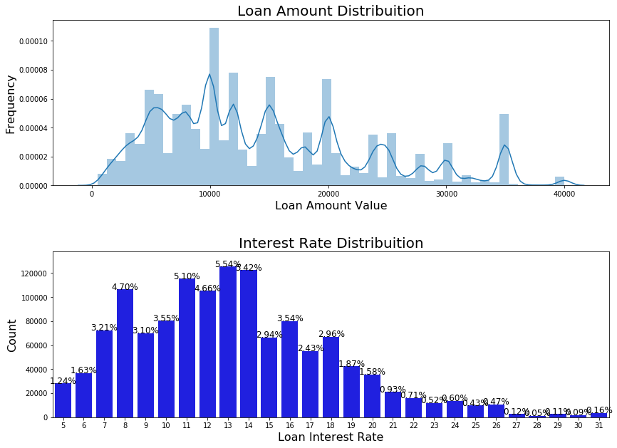
EDA

Slide 9
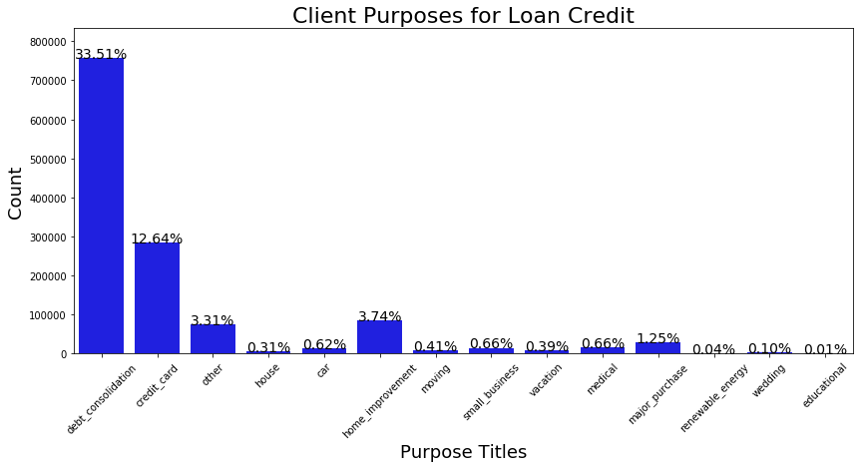
EDA

Slide 10
FEATURE ENGINEERING
For accepted data created column ‘Accepted’ with value = 1, for rejected the value = 0
Translated 'Employment.Length‘ to 'Experienced‘ with Emp.Length >= 6 as 1 else 0
Created 'loan_title’ from 'title‘ by shortening the title with more generalization
Created 'DebtToIncome_Ratio’ from ‘dti‘ with calculations mentioned earlier
Prepared the dummies from 'home_ownership‘, created variables post fixed with 'RENT', 'OWN', 'MORTGAGE', 'OTHER', 'NONE', 'ANY‘ along with data.
Prepared the dummies from 'verification_status‘, created variables post fixed with 'Verified', 'Source Verified', 'Not Verified' along with data.
The variable ‘loan_status_multiclass’ is created from ‘loan_status’ by ranking as below:
'Default':3
'Current’ & 'Fully Paid':4
'In Grace Period':0
'Upto1MonthLate':1
'Upto4MonthsLate':2

Slide 11
FEATURE ENGINEERING (Continued)
Converted all two class values to binary variables
debt_settlement_flag
initial_list_status
hardship_flag
pymnt_plan
application_type
The dummy variables were created for variable ‘loan_title’ post fixed with 'other', 'personal_loan', 'debt_consolidation', 'home_improvement', 'medical', 'small_business', 'moving', 'vacation', 'car', 'major_purchase', 'credit_card', 'house‘
The dummy variables were created for variable ‘loan_title’ post fixed with 'credit_card', 'car', 'small_business', 'other', 'wedding', 'debt_consolidation', 'home_improvement', 'major_purchase', 'medical', 'moving', 'vacation', 'house', 'renewable_energy', 'educational’

Slide 12
Dropped Variables
Dropped the predictors which has more than 50% null values.
'Policy Code‘ as it is unique
"mths_since_last_delinq" as it is having Percentage of Null Value : 49.87
id: as it is an identity/unique number in dataset which have no isgnificance
grade: as the value available in sub-grade also
emp_title: we have emp_length as employment duratin which is more promision than title
issue_d: as date issues it is not relavent to the payment
url: not having any relavence with payment
policy_code: as the value always 1
addr_state: As assuming that the geographical value is not having effect on default
zip_code: As assuming that the geographical value is not having effect on default

Slide 13
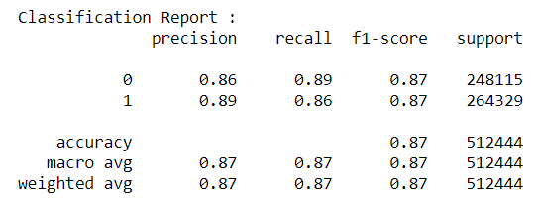
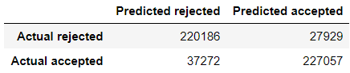
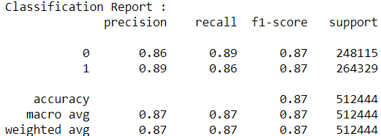

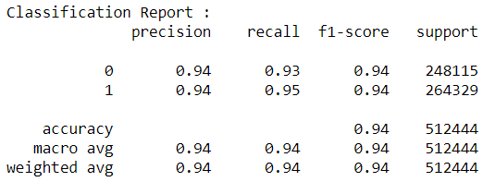
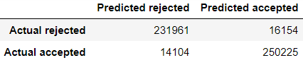
MODEL I: ACCEPTANCE MODEL
LOGISTIC REGRESSION
DECISION TREES
RANDOM FORESTS

Slide 14
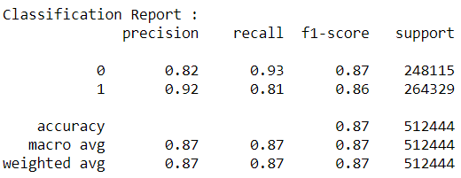
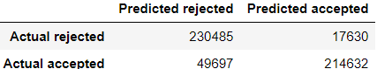
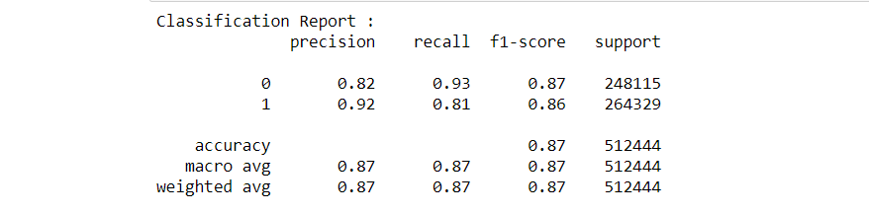
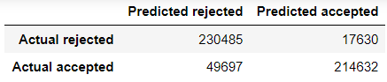
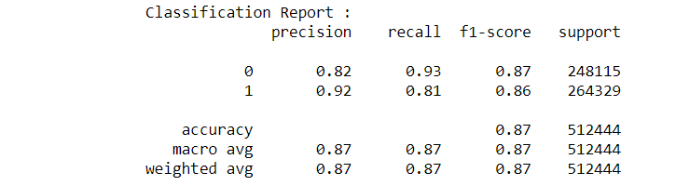

MODEL I: ACCEPTANCE MODEL
NAIVE BAYES
BAGGING CLASSIFIER
BOOSTING CLASSIFIER

Slide 15
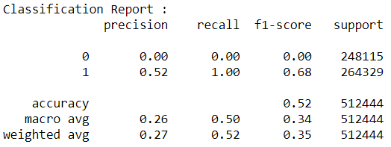
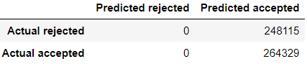
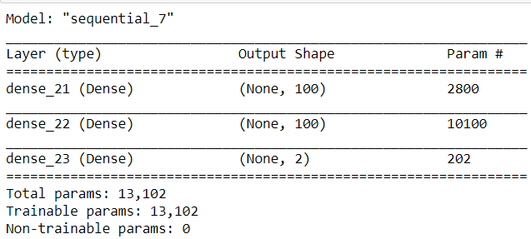
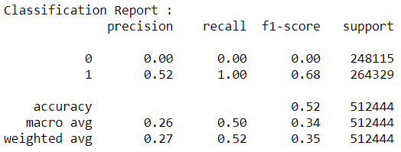

MODEL I: ACCEPTANCE MODEL
MLP
Keras

Slide 16
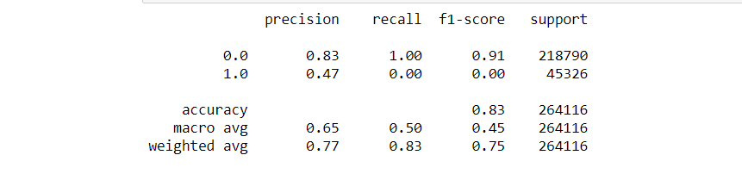
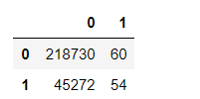
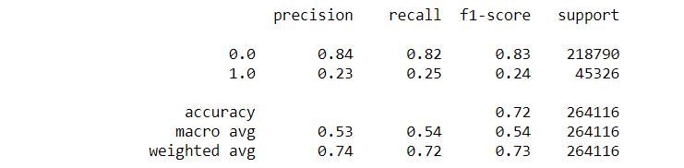
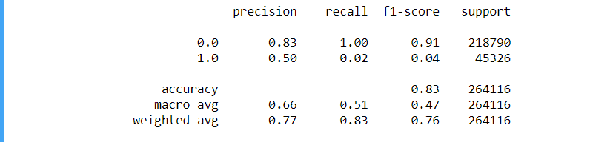
MODEL II: BINARY Classification
LOGISTIC REGRESSION
DECISION TREES
RANDOM FORESTS

Slide 17
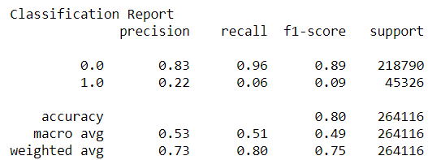

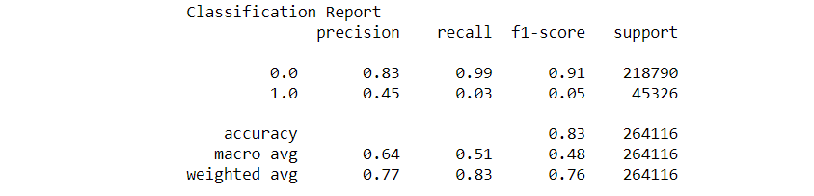

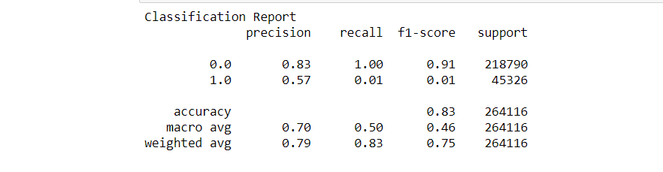

MODEL II: BINARY Classification
K-NEAREST NEIGHBOUR
BAGGING CLASSIFIER
BOOSTING CLASSIFIER

Slide 18
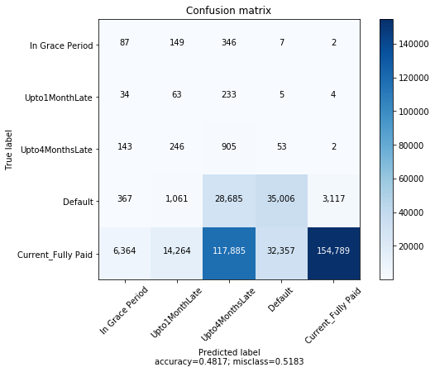
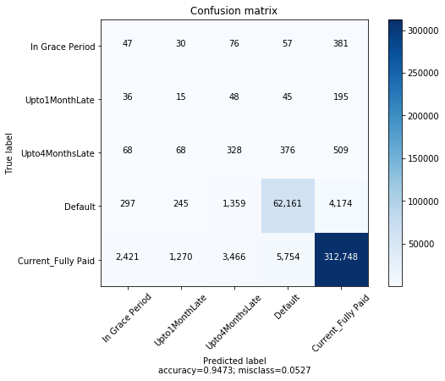
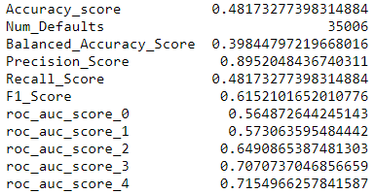
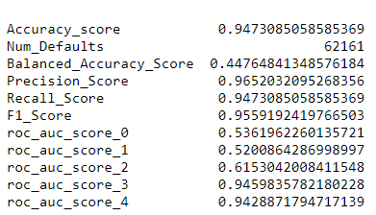
MODEL III: MULTICLASS CLASSIFICATION
Logistic Regression
Decision
Trees

Slide 19
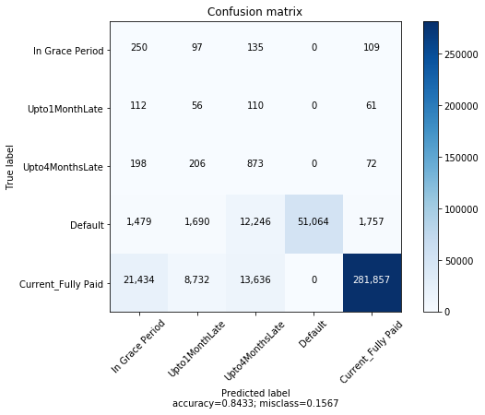
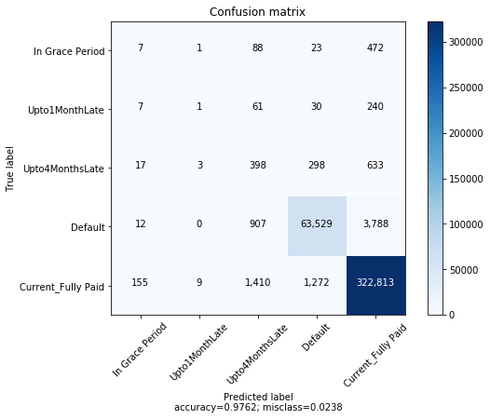
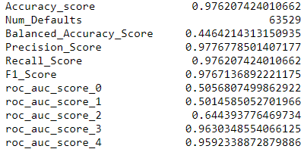
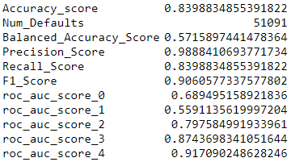
MODEL III: MULTICLASS CLASSIFICATION
Random
Forest
Bagging

Slide 20

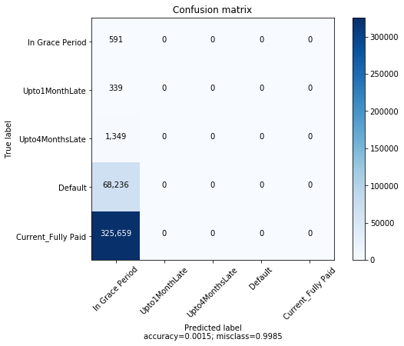
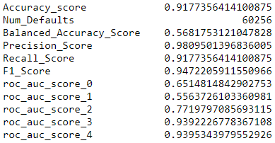
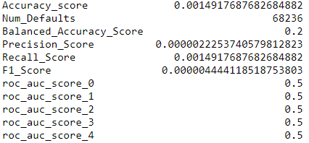
MODEL III: MULTICLASS CLASSIFICATION
Boosting
MLP

Slide 21
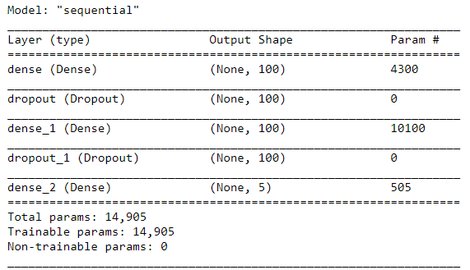
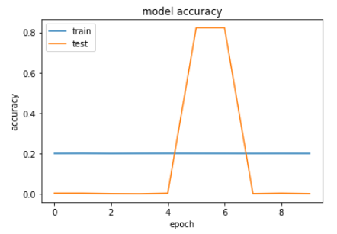
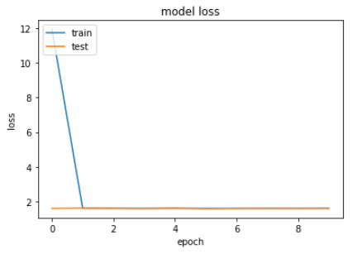
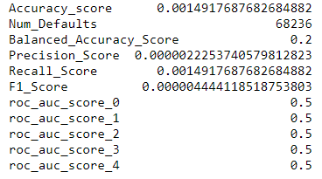
MODEL III: MULTICLASS CLASSIFICATION
Kearas

Slide 22
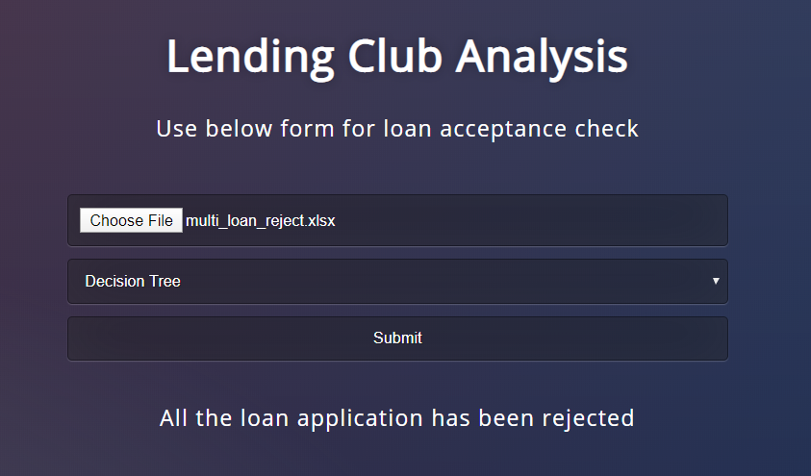
User Interface(UI) Demo

Slide 23
Demo video slide

Slide 24

Thank You

